Slide 1
Popular Flight Destinations
Jack Grimm, Marcus Hounsom, Al Faust

Slide 2

Objective
Using data provided by The Bureau of Transportation, determine the most traveled to states in the US.

Slide 3
Data Source & Limitations

Slide 4
Data Source & limitations
Primary data source is The Bureau of Transportation Statistics (BTS) through the United States Department of Transportation (link)
Due to size of data files available, only data from 2019 was gathered and used in this analysis.
Since this flight data was gathered across both public and commerce flights, specific passenger data is not recorded. this includes:
passenger id number
flight number
time of departure/arrival
Notes:
Further analysis would like to be done for year over year to determine if the passenger volume patterns explored in 2019 are similar in past years.

Slide 5
Analysis Process

Slide 6

Clean Up
Thankfully, the BTS website allowed for specific columns of data to be added or removed before download. This significantly cut down on the amount of time needed to clean and re-organize the data leaving us with a few loose ends to clean up:
Removed blank column that appeared after conversion
Renamed all columns for better readability
Removed US territories
Due to the overall size of the .csv’s, we were forced to upload these files in a compressed folder. This caused us to perform an additional step to extract the data into our code. It’s unclear at this time if this step also prevented the use of “for loops” due to the unknown formating of the data during the open and read process.

Slide 7

Exploration
We first gathered data regarding total passenger volume per state for arriving and departing flights to determine which states to focus.
Once those states were determined. We further broke down the data into 4 categories:
Top 5 airports that had the most passengers arriving
Top 5 airports that had the most passengers departing
Top 5 airports that were receiving passengers from the target state.
Passenger Volume per quarter

Slide 8
Visualization

Slide 9
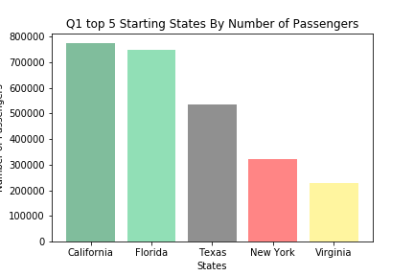
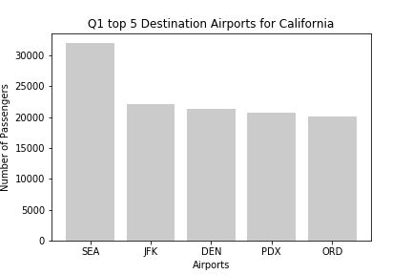
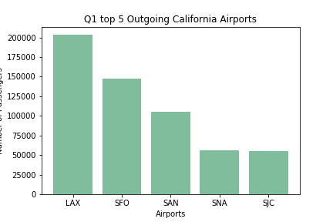
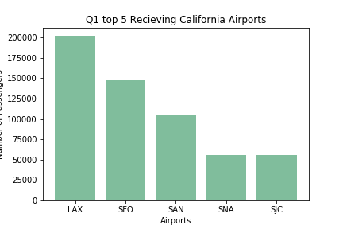
*data is limited to California for readability
Notes:
In these charts, we’ve limited the data to simply california to help with readability. This same analysis was conducted on Florida, Texas, New York and Virginia.
Top right
SEA-Seattle-Tacoma International Airport
JFK - John F. Kennedy International Airport
DEN - Denver International Airport
PDX - Portland International Airport
ORD - O'Hare International Airport
Btm left and right
LAX - Los Angeles International Airport
SFO - San Francisco International Airport
SAN - San Diego International Airport
SNA - John Wayne Airport
SJC -Norman Y. Mineta San Jose International Airport

Slide 10
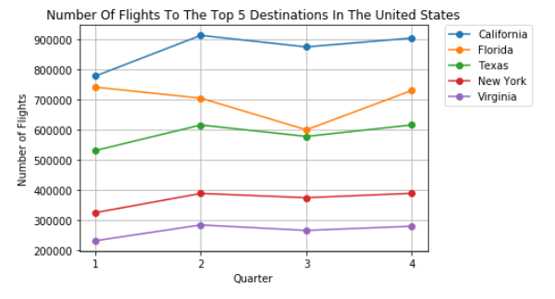
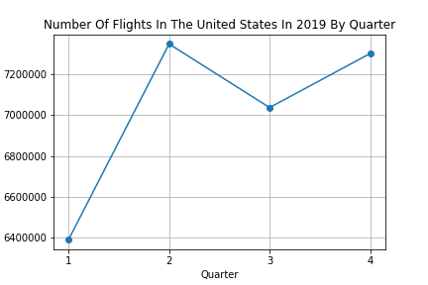
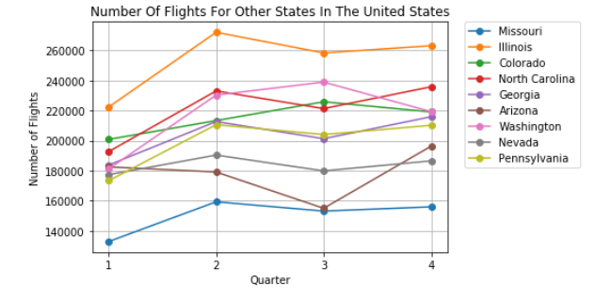
*National data used for holistic view

Slide 11
Conclusion

Slide 12
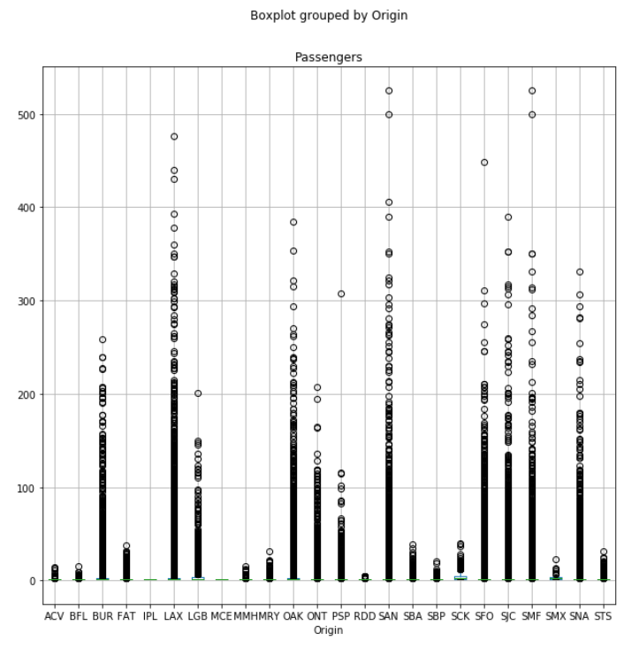
ANOVA Test
Looking at the quarter one data of California’s airport starting points or Origin, we conducted an ANOVA test on the top 5 airports to determine if there were any similarities that could be drawn between the number of passengers per entry and the starting point.
With a p-value of approximately 4.1, we can say that there is no real correlation between the number of passengers per entry and the starting point.

